Slide 2
The EIB Group
Providing finance and expertise for sound and sustainable investment projects
Leading developer of risk financing for innovative SMEs

Slide 3
The EU bank
Natural financing partner for the EU institutions since 1958
Around 90% of lending is within the EU
Shareholders: 28 EU Member States
Investing in Europe’s growth

Slide 4
The EIB at a glance
Largest multilateral lender and borrower in the world
Raise our funds on the international capital markets
Pass on favourable borrowing conditions to clients
Some 450 projects each year in over 160 countries
Headquartered in Luxembourg and 33 local offices
Around 2 900 staff:
Not only finance professionals, but also engineers, sector economists and socio-environmental experts
More than 50 years of experience in financing projects

Slide 5
EIB Group track record: over EUR 500bn lent since 2008

Slide 6
We focus on our key priorities
ENVIRONMENT
EUR 19.6bn
INFRASTRUCTURE
EUR 18.9bn
INNOVATION
EUR 18.7bn
SME
EUR 29.2bn

Slide 7
We are the world’s largest provider of climate finance
>25% worldwide
35% in world’s
developing regions
EIB’s 2015 Climate Strategy
We are increasing our climate commitment:
USD 100bn over next 5 years

Slide 8
We are the world’s largest multilateral financier
Record for the
EIB Group:
EUR 84.5bn
EIB in 2015:
EUR 77.5bn
EIF in 2015:
EUR 7bn

Slide 9
Our products
We help catalyse investment
LENDING | BLENDING | ADVISING
Loans But also: Guarantees (trade financing) Equity participation | Combining EIB finance with EU budget (Project Bond Initiative) Higher risk projects for innovation (InnovFin) | Prepare, evaluate and support the implementation of projects (JASPERS) Support for public/private partnerships (EPEC)
Attracting FUNDING for long-term growth

Slide 10
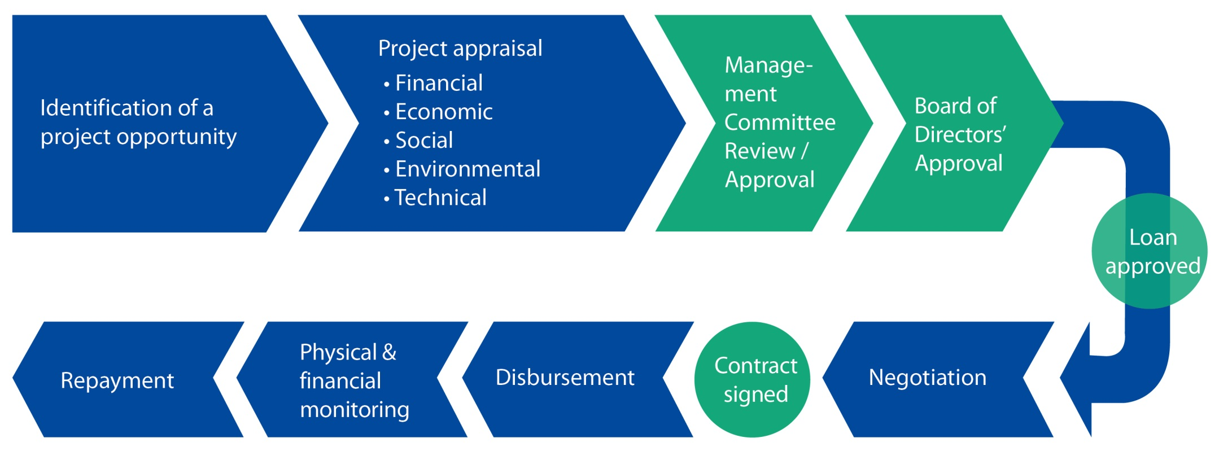
EIB project cycle
We support sound and sustainable projects

Slide 11
European Fund for Strategic Investments (EFSI)

Slide 12
A responsible bank
Corporate responsibility is part of all of our activities
We strive to improve the lives of people by promoting sustainable and inclusive growth
We are committed to:
integrating high environmental and social standards into our business activities;
ensuring strong governance, transparency and accountability, for us and our counterparts;
minimising our own environmental footprint.

Slide 13
We are the world’s largest supranational borrower
Total 2015 borrowing: EUR 62.4bn
Mobilising resources worldwide
We are the
largest issuer of green bonds
Middle East & Africa
2%
EUR 4bn
in 2015
Americas
14%
Asia
21%
Europe
63%
EUR 11bn
in 11 currencies since 2007

Slide 14
Energy efficiency within the EIB
EIB is a policy driven organisation
EE has been defined as key priority of the EU and is therefore an embedded priority in EIB operations
At appraisal the resource efficiency, including EE potential, of all EIB operations will be assessed
If applicable, relevant indicators will be defined to monitor EE outturn values after implementation vs. values at appraisal
In case the appraisal identifies further EE potential these will be discussed with promoters trying to unlock additional potential via undertakings and/or TA
Americas
14%
Asia
21%
Europe
63%

Slide 15
The EIB tool kit/TA
Upstream, the EIB group can provide technical assistance (TA) for EE projects
In case of larger EU co-financed projects JASPERS assistance is available via the managing authority to help eligible promoters to prepare projects
For non EU co-financed projects EIB can assist its promoters to define dedicated TA solutions improving EE potential of the underlying projects during project appraisal
The ELENA facility, managed by EIB, provides dedicated TA to promoters that plan, inter alia, EE projects to finalise the project preparation (studies, designs, tender dossiers), energy audits and support the implementation (financing PIU costs)

Slide 16
The EIB tool kit/TA
For TA enquiries the Investment Plan for Europe (IPE) helps by creating the European Investment Advisory Hub (EIAH)
The EIAH aims to strengthen support for project development and preparation across the Union building on the expertise of the EU Commission, the EIB Group, National Promotional Institutions and Member States’ Managing Authorities
A single point of entry to a wide range of advisory and technical assistance programmes and initiatives for public and private beneficiaries
---> www.eib.org/eiah

Slide 17
The EIB tool kit/Standard products
For large projects with investment costs (IC) in excess of EUR 100m → INVESTMENT LOANS or FRAMEWORK LOANS
For medium sized projects with IC between EUR 25m < IC < EUR 100 m → dedicated INTERMEDIATED LOANS with local partner banks
For small projects with IC < EUR 25m → multi-purpose and multi-sector intermediated bank loans (MBILs) with local partner banks available in all Member States (see www.eib.org)

Slide 18
The EIB tool kit/PF4EE
Private Finance for Energy Efficiency (PF4EE) is a joint instrument of the EIB Group and the European Commission (EC) to support the financing of energy efficiency (EE) investments
It comprises:
A loan to a commercial bank to be on-lent for financing of energy efficiency investments (“EE Loan”)
A risk mitigation mechanism, which covers losses incurred in the portfolio of EE loans granted by the commercial bank to on-lend the EE Loan (“Risk Sharing Facility”)
Consultancy services aiming at supporting the commercial bank to create the abovementioned EE loans portfolio (“Expert Support Facility”)

Slide 19
The EIB tool kit/PF4EE
General EE
Eligibility Criteria
Eligible energy efficiency projects should be compliant with EIB policy and with similar programs of Member States.
Additional specific criteria apply for District Heating / District Cooling, Energy Savings / Energy Efficiency in Buildings and High efficiency Co-Generation of Heat and Power
Energy savings, including environmental externalities, should at least cover 50% of the project cost.
EIB and EU rules apply to select Energy Efficient investments
Ideally PF4EE should be combined with an Energy Efficient grant program to simplify and stimulate eligible investments

Slide 20
The EIB tool kit/PF4EE
PF4EE objectives are:
Making energy efficiency lending a more sustainable activity across European financial institutions
To encourage private commercial banks and other financial intermediaries to address the energy efficiency sector as a distinct market segment
To increase lending for energy efficiency in response to priorities identified by Member States’ National Energy Efficiency Action Plans.
Benefits for final recipients
More funding possibilities completing EU or national grants
Longer tenors and advantageous pricing terms due to obligation on financial intermediaries to pass on financial advantage as per normal EIB practice
TA framework within the facility ensuring sound projects

Slide 21
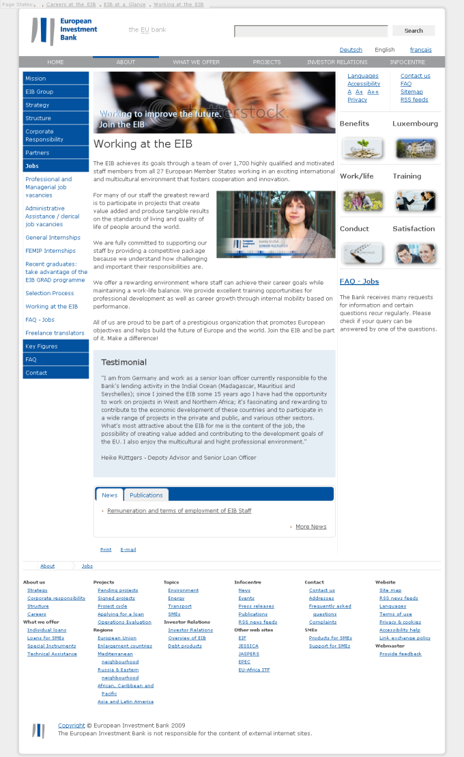
Contact Information
Jean-Marc MARTIN
Deputy Head of Division
Public Sector Lending Operations
Croatia, Slovenia, & Western Balkans
martinjm@eib.org
98-100 boulevard Konrad Adenauer
L-2950 Luxembourg
Tel: +352 43 791
www.eib.org
www.eib.org/eiah
www.eib.org/pf4ee
www.eif.org
HVALA!
Notes:
21

